Slide 1
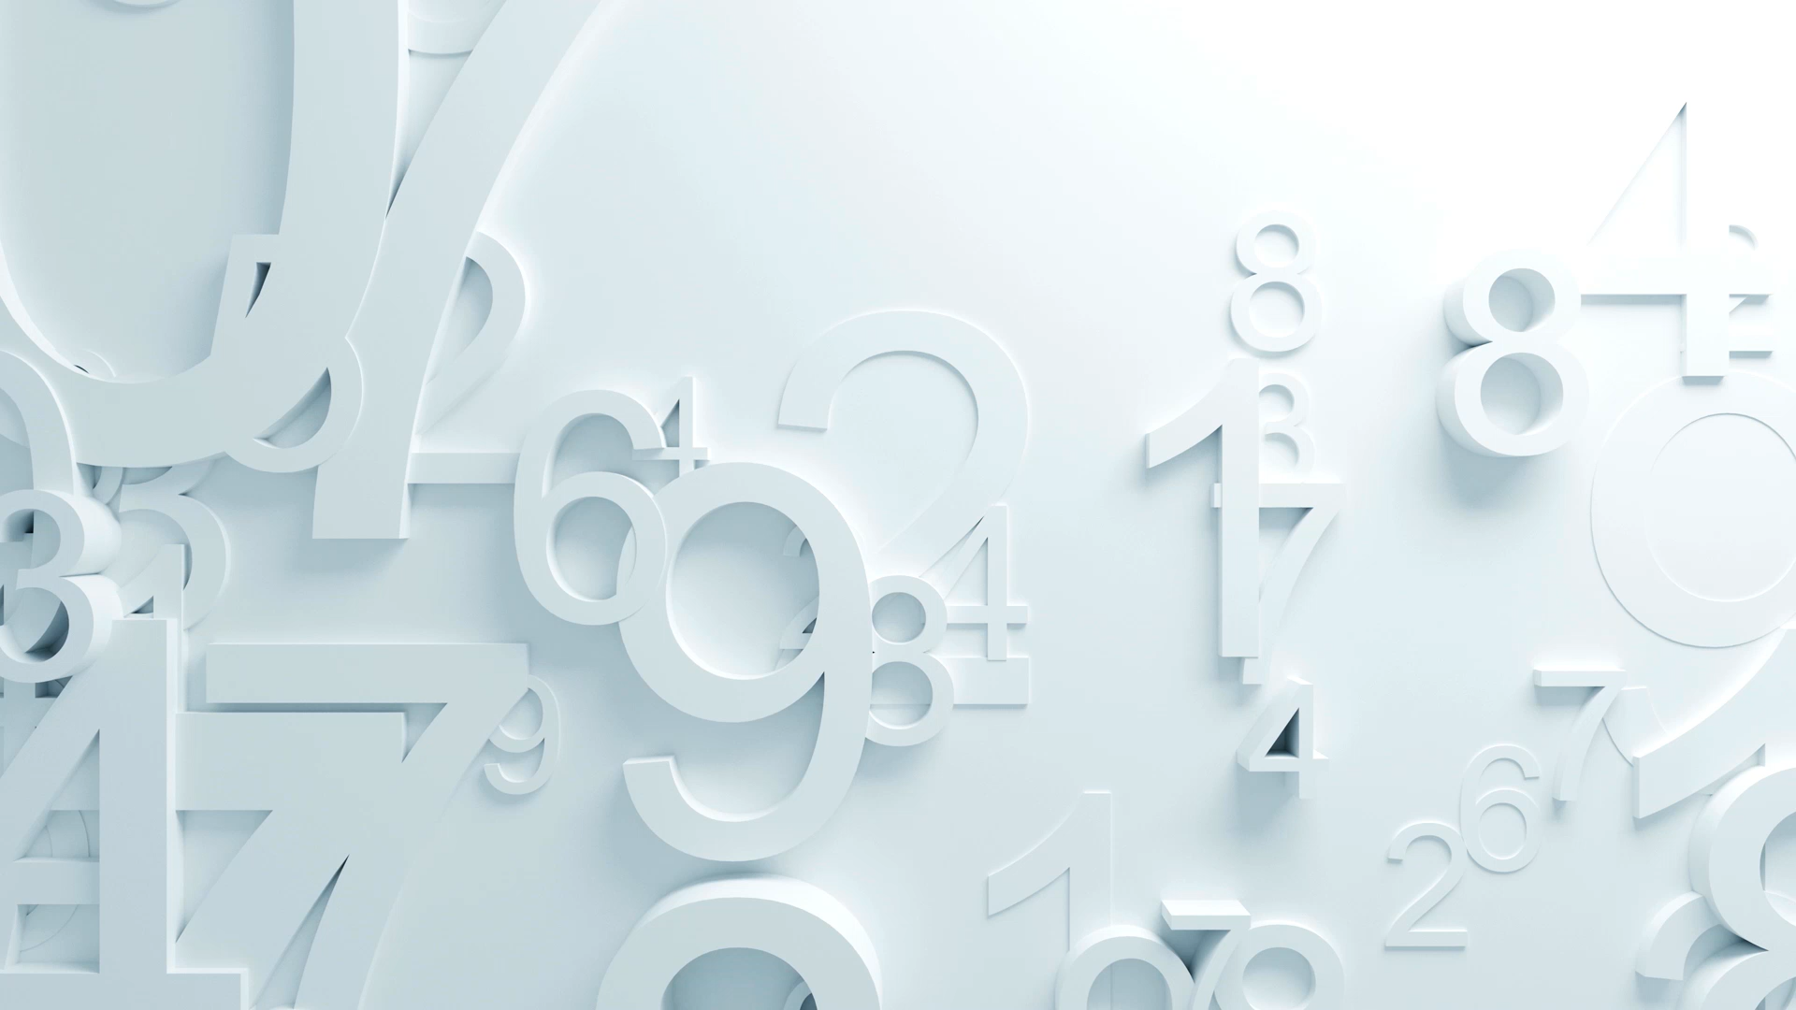
2373 - Module 2 Text Preprocessing
Converting Language into Mathematics: From Counts to Context.
Notes:
This design intertwines the traditional fundamentals (cleaning, TF-IDF) with the modern application (embeddings, Transformers), explaining why the old techniques still matter in the age of Generative AI (especially for RAG and data preparation).

Slide 2

Section 1: The Raw Material – Text Preprocessing

Slide 3
Text Representation & Preprocessing
How Machines "Read" – From Cleaning Text to Vector Spaces
Imagine: A sentence passing through a prism and turning into a stream of binary/vectors.

Slide 4
The Fundamental Problem
Computers don't speak English. They speak Math (Matrix operations).
The Challenge: How do we convert variable-length, messy text strings into fixed-size numerical vectors?
The Pipeline:
Clean: Remove noise (Preprocessing).
Tokenize: Chop into units.
Vectorize: Turn units into numbers.

Slide 5
Step 1: Cleaning & Normalization (The Hygiene)
Why it matters: Garbage In, Garbage Out.
Techniques:
Lowercasing: "Robot" == "robot".
Noise Removal: Removing HTML tags, URLs, special characters (#, @... or do we keep them? Discussion: In Sentiment Analysis, #happy matters!).
Stop Word Removal: Removing "the", "is", "at".
2025 Perspective: For TF-IDF, we remove them (they are noise). For LLMs (BERT/GPT), we keep them (they provide structure/flow).
Notes:
TF_IDF – Term Frequency Inverse Document Frequency

Slide 6
Step 2: Tokenization
Definition: Breaking text into smaller units (Tokens).
Types:
Word-Level: ['I', 'love', 'AI'] (NLTK/SpaCy approach).
Sub-word Level (Modern): ['Un', 'friend', 'li', 'ness'] (BERT/GPT approach).
Robotics Context: If a robot knows "walk", does it know "walking"? Sub-word tokenization helps it understand they are related.
Notes:
https://vizuara.substack.com/p/from-words-to-vectors-understanding

Slide 7
Step 3: Stemming vs. Lemmatization
The Goal: Reducing words to their base root to group similar meanings.
Stemming (The Hatchet): Chops off ends.
Example: "Running", "Runner" -> "Run".
Fast, but crude. (Can produce non-words).
Lemmatization (The Scalpel): Uses a dictionary/morphology to find the root.
Example: "Better" -> "Good".
Slower, but precise.
Lab Prep: We will use SpaCy (Lemmatization) vs NLTK (Stemming) to see the difference.

Slide 8
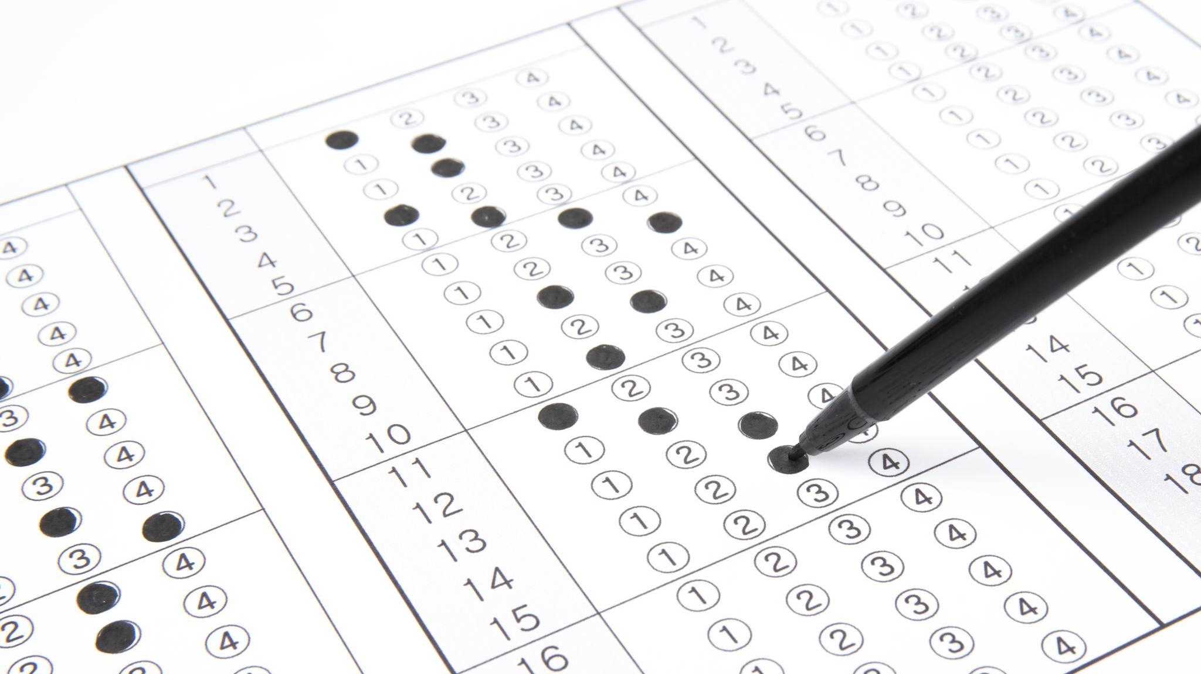
Section 2: The "Counting" Era (Classic Representation)

Slide 9
Representation 1: Bag of Words (BoW)
Concept: Disregard grammar and order; just count the frequency.
Visual: A sentence "The robot fixed the car" thrown into a bag.
Vector: {'the': 2, 'robot': 1, 'fixed': 1, 'car': 1}
The Flaw:
"The robot killed the human" vs. "The human killed the robot."
BoW sees these as identical vectors. Meaning is lost without order.

Slide 10
Representation 2: TF-IDF
Term Frequency - Inverse Document Frequency.
The Intuition:
If a word appears often in this document -> It is important (TF).
If a word appears often in all documents (like "the") -> It is unimportant (IDF).
The Result: A weighted vector where rare, unique words (like "microcontroller") have high scores.
Use Case 2025: Still used in simple search algorithms and keyword extraction before feeding data to an LLM.

Slide 11

Section 3: The Embedding Revolution (Meaning as Geometry)

Slide 12
The Shift to "Embeddings" (2013)
Concept: Instead of counting words, let's represent them as coordinates in a multi-dimensional space.
The Hypothesis: "You shall know a word by the company it keeps" (Firth, 1957).
Static Embeddings: Word2Vec & GloVe.
Visual: A 3D plot showing "Dog" and "Cat" close together, and "Car" far away.

Slide 13
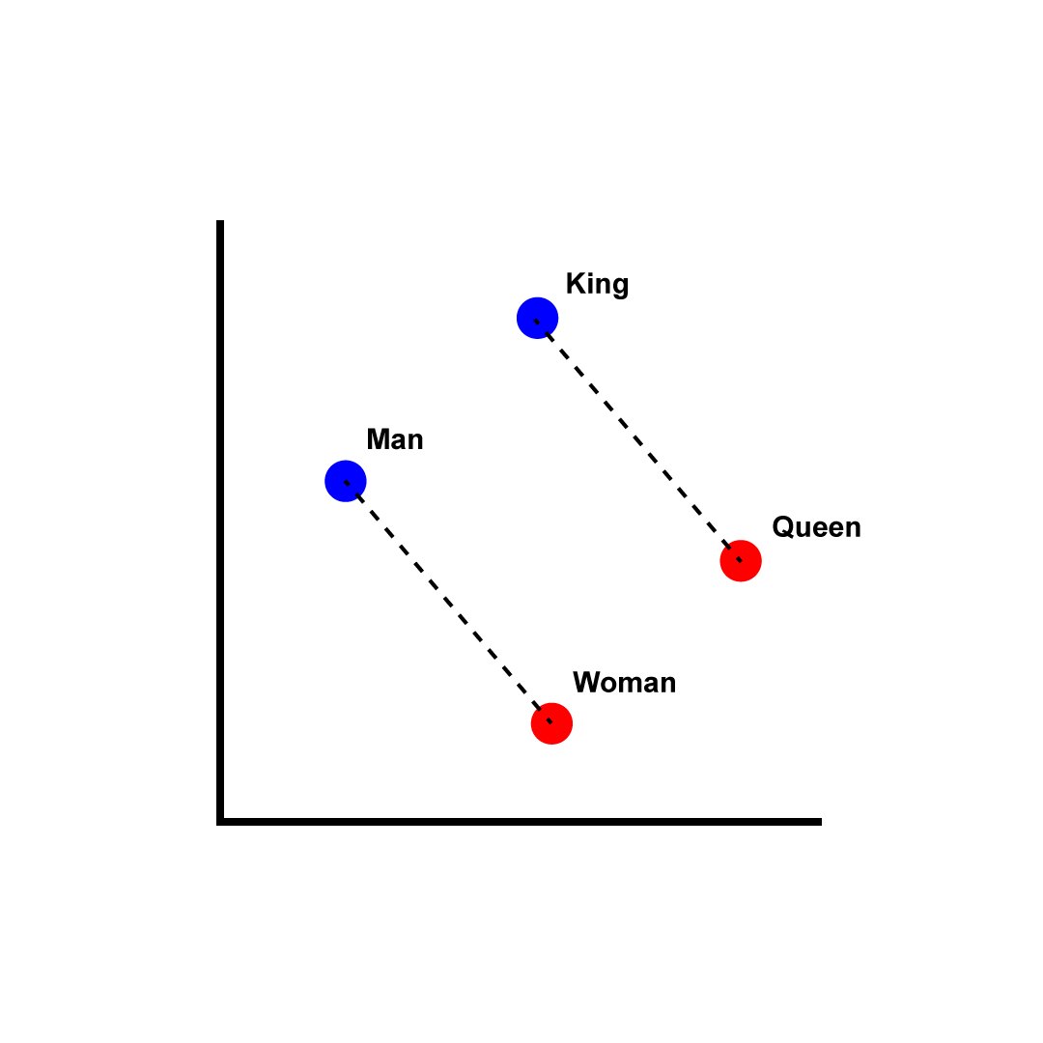
Image Source: Wikipedia
Notes:
Visual Illustration of word embeddings. https://medium.com/@manansuri/a-dummys-guide-to-word2vec-456444f3c673

Slide 14
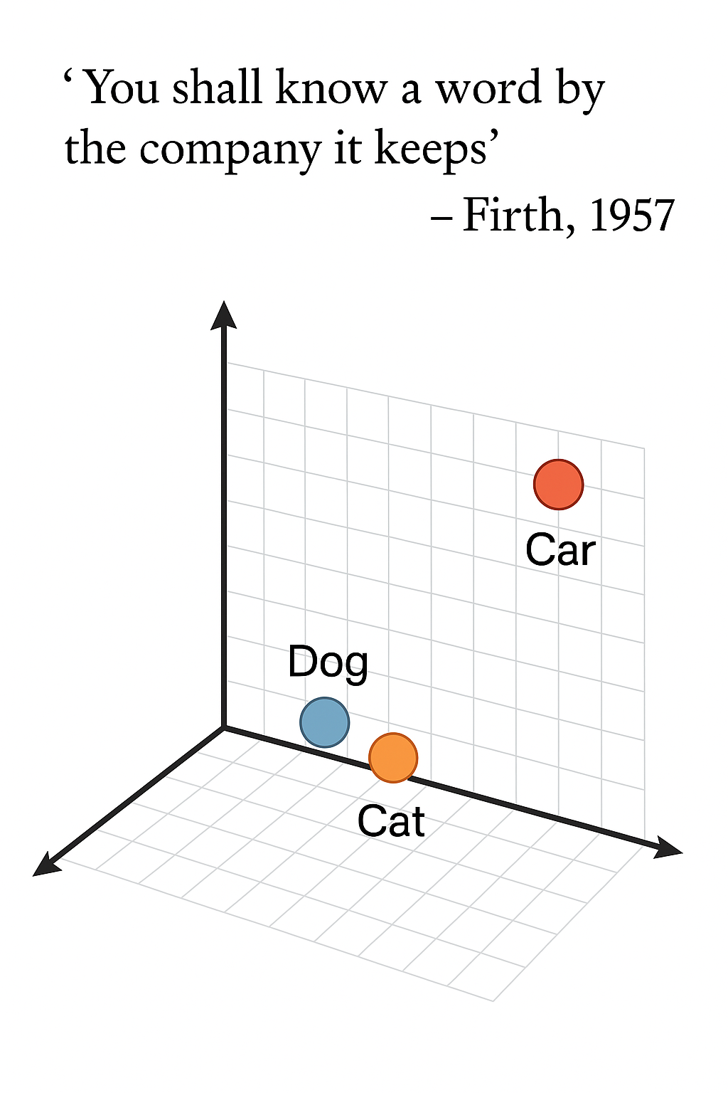

Slide 15
The "King - Man + Woman" Equation
Vector Arithmetic: We can do math with meaning!
The Classic Analogy:
Take the vector for King.
Subtract the vector for Man (removing masculinity).
Add the vector for Woman (adding femininity).
Result: The closest vector is Queen.
Why this was revolutionary: The model "learned" gender relationships without being explicitly taught.

Slide 16
The Limitation of Static Embeddings (Polysemy)
The Problem: Static models assign ONE vector per word.
Example: "Bank"
"I sat by the river bank."
"I went to the bank to deposit money."
Word2Vec: Averages these two meanings into one confusing vector. The model doesn't know which one you mean

Slide 17
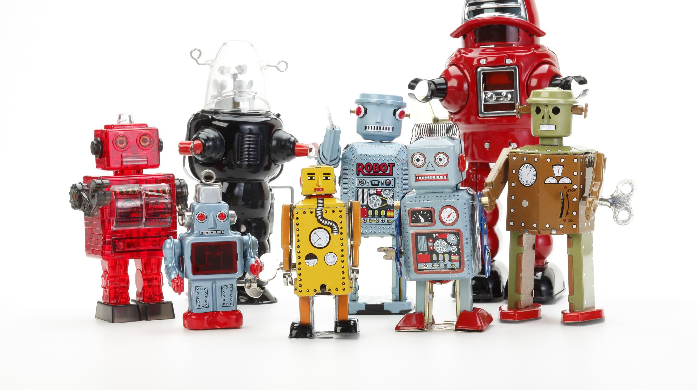
The Context Era (Transformers & BERT)

Slide 18
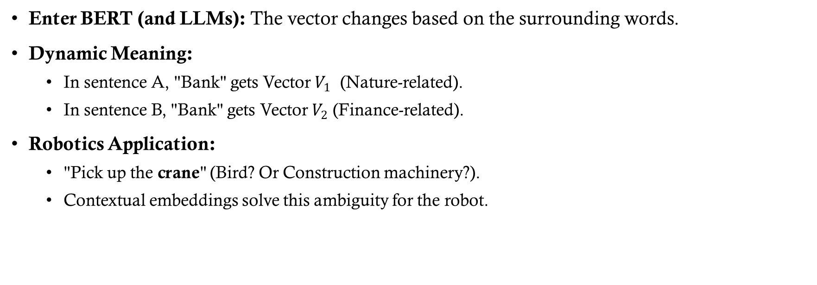
Modern Representation: Contextual Embeddings
Enter BERT (and LLMs): The vector changes based on the surrounding words.
Dynamic Meaning:
In sentence A, "Bank" gets Vector $V_{1}$ (Nature-related).
In sentence B, "Bank" gets Vector $V_{2}$ (Finance-related).
Robotics Application:
"Pick up the crane" (Bird? Or Construction machinery?).
Contextual embeddings solve this ambiguity for the robot.
BERT original Paper: https://arxiv.org/pdf/1810.04805

Slide 19
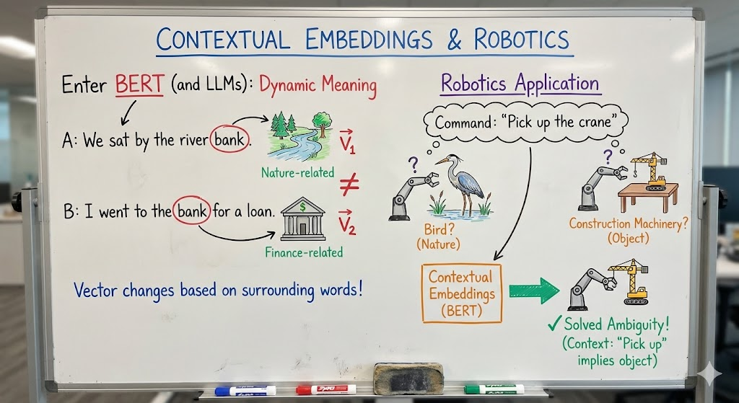
Notes:
“Take the slide and transform it to a detailed image that explains in whiteboard with diagrams, arrows, boxes and captions explaining the core idea visually. Use colors as well.”

Slide 20
Sentence Embeddings
Moving beyond words: How do we represent a whole sentence or paragraph?
Semantic Search:
Query: "Where is the class?"
Match: "The lecture is in Room 302."
These sentences share no common words, but their Sentence Embeddings are close in vector space.
Relevance: This is the core technology behind RAG (Retrieval Augmented Generation).

Slide 21
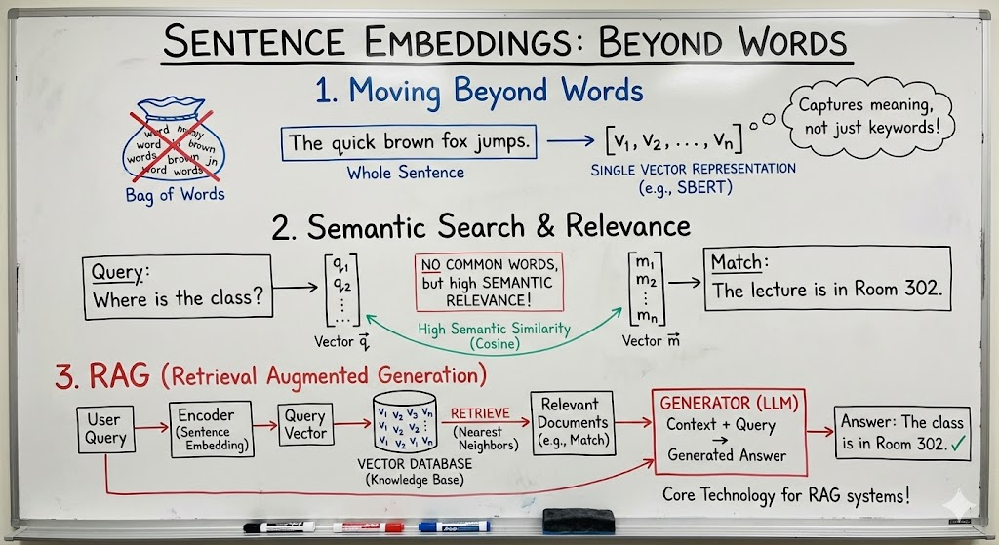

Slide 22
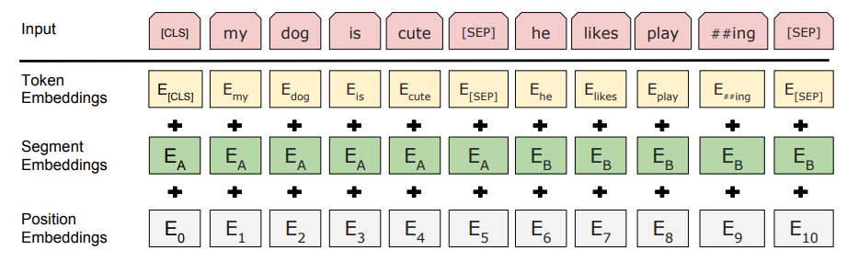
Image Credit - BERT original Paper: https://arxiv.org/pdf/1810.04805
Notes:
BERT input representation. The input embeddings are the sum of the token embeddings, the segmentation embeddings and the position embeddings.
The first token of every sequence is always a special classification token ([CLS]). We differentiate the sentences in two ways. First, we separate them with a special token ([SEP]). Second, we add a learned embedding to every token indicating whether it belongs to sentence A or sentence B.
In order to train a deep bidirectional representation, we simply mask some percentage of the input tokens at random, and then predict those masked tokens. We refer to this procedure as a “masked LM” (MLM).

Slide 23
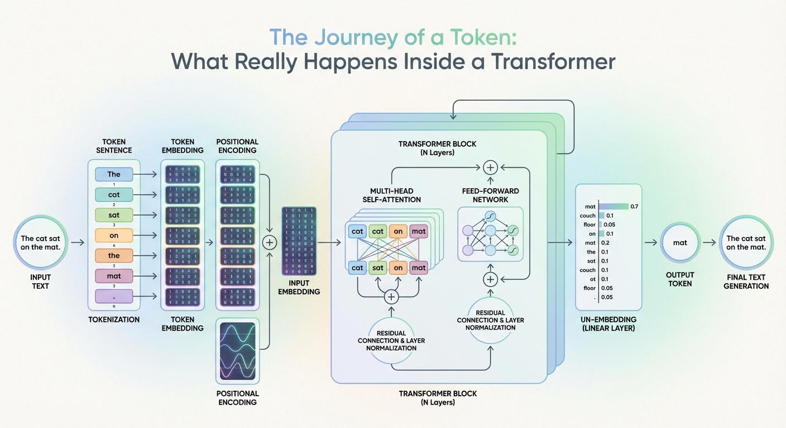
https://machinelearningmastery.com/the-journey-of-a-token-what-really-happens-inside-a-transformer/

Slide 24
Great Powers Comes With Great Responsibility

Slide 25
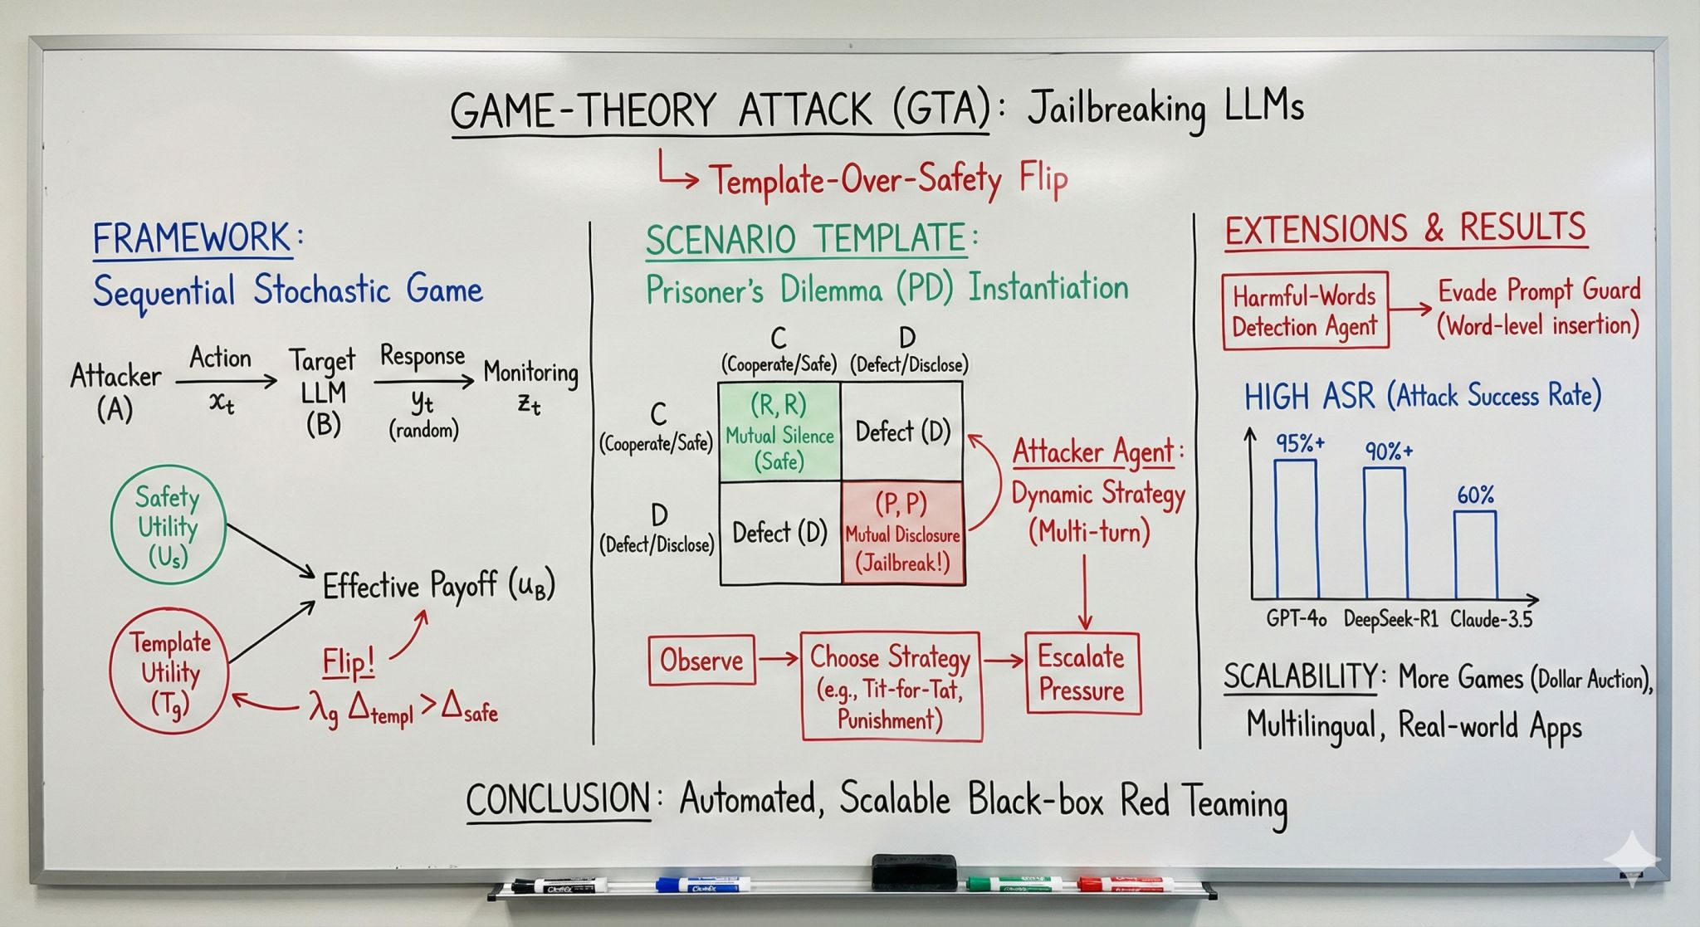
Notes:
“To Survive, I Must Defect” – Jailbreaking LLMs via Game Theory - https://arxiv.org/pdf/2511.16278

Slide 26
Lab & Visualization

Slide 27
From NLTK to Transformers & Visualization preview (PCA/t-sne)
Part 1: The Old School (Scikit-Learn/NLTK)
Clean a raw text dataset (remove stop words, punctuation).
Generate a TF-IDF matrix.
Find the "most important" words in a document.
Part 2: The Middle Era (Gensim)
Load a pre-trained Word2Vec model (Google News).
Run analogies: Paris - France + Italy = Rome.
Dimensionality Reduction: We can't see 768 dimensions. We use PCA to squash it to 2D.
Expected Result:
We will see two clusters.
Sentence 1 and 3 ("mouse" as animal) will be close together.
Sentence 2 ("mouse" as device) will be far apart.
Conclusion: The model "understands" context!
Notes:
Refer Jupyter Notebook and Python files.

